Slide 1


Department of Information Science & Engineering
Dept. of ISE

Slide 2
Mini Project(BIS586) Presentation –(2024 -2025)
TITLE: ONE APP
Batch No:-
Project Team Members:
Vishnu MT 1AY22IS129
Thushar Raj S G 1AY22IS117
Vishal M Bharadwaj 1AY22IS128
Rakshith Gowda M 1AY22IS074
Under the Guidance of
Prof. Mrs.Vinutha Raghu
Assistant Prof.
Department of ISE
Acharya Institute Of Technology
Dept. of ISE

Slide 3
Agenda
Abstract
Introduction
Problem Statement
Requirement Specification(Hardware & Software)
System Design
(Flow Charts, Class Diagram, Use Case Diagram,
Activity diagram)
7. Implementation (All Modules)
8. Testing
9. Test Cases
10. Results(Snapshots)
11. Conclusion
12. Future Enhancements
13. References
Dept. of ISE

Slide 4
Abstract
This revolutionary smart lifestyle management app organizes everyday tasks by embedding AI with voice recognition. Integrating tools like alarm management, to-do lists, note-taking ,expense tracker and reminders into a single, intuitive interface makes it unmatched in terms of convenience. With its advanced voice recognition, it is now easy for anyone to enter tasks into widgets from anywhere through simple speech commands, further streamlining how people of any technical proficiency manage tasks. Another area where AI assistant improves user experience is by answering simple questions that provide helpful insights and smoothing out daily planning. Thus, this combination of intelligent features with user-centric design makes it a game-changer for simplifying and organizing daily life without any hassle and accessibility issues.
Dept. of ISE

Slide 5
INTRODUCTION
This smart lifestyle management app integrates all the necessary tools—alarm management, to-do lists, notes, reminders, and an expense tracker—into one user-friendly interface. Advanced voice recognition enables users to add tasks using natural speech. Powered by the Gemini AI API, the app's assistant answers basic questions with precision, enhancing usability. By combining efficient task organization with seamless financial tracking, the application ensures comprehensive life management. Designed for accessibility and productivity, it offers a streamlined solution for managing daily tasks, commitments, and finances, tailored to modern lifestyle needs.
Dept. of ISE

Slide 6
PROBLEM STATEMENT
Management of tasks, reminders, notes, alarms, and finances in separate tools is not effective and disorganized. Most users find it challenging to integrate critical activities and hence miss their commitments, struggle with time or expense management. Apps in the market lacks intuitive interfaces and voice recognition, making it less easy to use. This project integrates the most user-friendly tool for easy management of daily tasks and finance, providing simple AI for instant answers along with voice recognition and making the use effective and accessible to everyone
Dept. of ISE

Slide 7
REQUIREMENT SPECIFICATION
Functional Requirements | Non-Functional Requirements
Alarm Management: Set, edit, delete alarms with customizable messages. | Usability: Easy-to-use interface for all user levels.
To-Do Lists: Create, edit, delete tasks with priority and categories. | Performance: Fast app load and response (under 2 seconds).
Note-Taking: Create, edit, delete notes with categories or tags. | Scalability: Support growing user data without performance loss.
Reminder System: Set, manage reminders with categorization. | Reliability: Stable, with secure data storage and backups.
Expense Tracker: Add, edit, delete expenses with categories and reports. | Accessibility: Compatible with screen readers and voice control.
Voice Recognition: Add tasks, notes, and reminders via speech. | Security: Secure user data, especially financial info.
AI Assistant: Answer basic queries and provide task suggestions. | Compatibility: Supports iOS, Android, and various devices.
User Interface: Simple, navigable interface with customizable widgets. | Maintainability: Well-documented, modular code for easy updates.
Dept. of ISE

Slide 8
REQUIREMENT SPECIFICATION
Hardware Requirements | Software Requirements
Operating System: Android 8.0 (Oreo) or higher. | Android Version: Android 8.0 (Oreo) or newer.
Processor: Quad-core CPU or better. | Permissions Required: Microphone access for voice commands.
RAM: Minimum 2GB (4GB recommended). | Notification access for alerts.
Storage: At least 100MB free space. | Network access for syncing and updates.
Microphone: Built-in microphone for voice commands. | Google Play Services: Required for notifications.
Network: Wi-Fi or mobile data for online features.
Hardware and Software requirements
Dept. of ISE

Slide 9
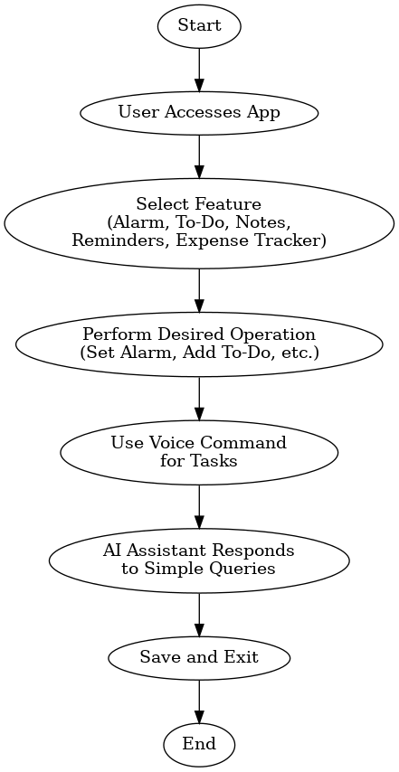
SYSTEM DESIGN
Flow chart
Dept. of ISE

Slide 10
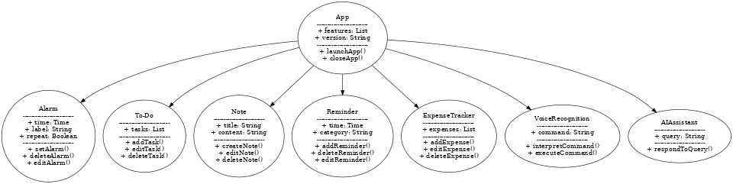
SYSTEM DESIGN
Flow chart
Dept. of ISE
Class Diagram

Slide 11
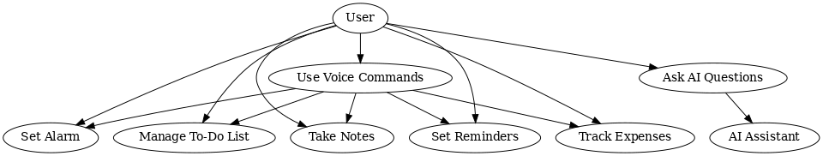
SYSTEM DESIGN
Dept. of ISE
Use case Diagram

Slide 12
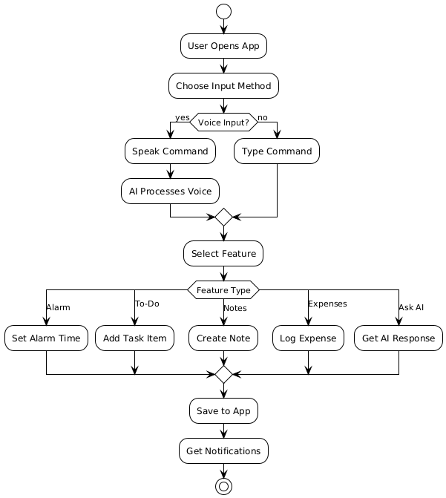
SYSTEM DESIGN
Activity Diagram
Dept. of ISE

Slide 13
IMPLEMENTATION
Note: List all the Modules of your Projects
and Provide brief explanation
(if you want you can place code snippets where ever it is required)
Dept. of ISE

Slide 14
TESTING
Note:- Explanation about how testing is carried for your Project
Dept. of ISE

Slide 15
TEST CASES
Note:- write 6 to 10 Test Cases in Table format for unit, integration and system Testing
Test Case No. | Type of Testing | Input | Expected Output | Obtained Result | Status of Test Case | Remarks
1 | Unit Testing(Login Module) | Login details | Password matched | Login Successful | Pass | NA
2 | Unit Testing (Login Module) | Login details | Password matched | Not showing the message | Fail | Write about how the login module error is resolved
Dept. of ISE

Slide 16
RESULTS
Note:- Place 5 to 6 Screenshots of your project
Dept. of ISE

Slide 17
CONCLUSION
In conclusion, this smart lifestyle management application integrates essential daily tools—alarms, to-do lists, notes, reminders, and an expense tracker—into a unified, user-friendly interface. Advanced voice recognition enhances the application by simplifying task input and navigation, catering to users of all technical backgrounds. The inclusion of an AI assistant powered by Gemini AI API provides quick answers to basic queries, further enhancing usability. Designed for efficiency and accessibility, the app will remove the fragmentation of managing and tracking finances and tasks by presenting a seamless, intelligent solution for modern lifestyles. This app empowers users to organize and optimize their daily routines with ease and precision.
Dept. of ISE

Slide 18
FUTURE ENHANCEMENTS
Dept. of ISE

Slide 19
References
[1]. Nama, P. (n.d.). AI-powered mobile applications: Revolutionizing user interaction through intelligent features and context-aware services. Retrieved from https://www.researchgate.net/.../AI-Powered-Mobile-Applications-Revolutionizing-User-Interaction-Through-Intelligent-Features-and-Context-Aware-Services.pdf
[2]. (n.d.). The application of real-time voice recognition to control critical mobile device operations. Retrieved from https://ijrsset.org/pdfs/v2-i7/23.pdf
[3]. (n.d.). User interface evaluation in the real world: A comparison of four techniques. Retrieved from
https://dl.acm.org/doi/pdf/10.1145/108844.108862
Dept. of ISE

Slide 20

Dept. of ISE

